Slide 1
“MEDIA PIPE PROJECT – INCOPORATING ASL, SENTENCE FRAMING AND AUDIO OUTPUT”
Presented by: Neha Mahanand
Data Science Internship Media Pipe Project Project (October 2024 batch)
Mentor: Sabir K
May, 2025

Slide 2
Contents
Project Background
Introduction and Objective
Methods and Work flow
Work Flow
Dataset creation
Model Creation
Capturing Phase
Application
Results as implementation in vs code

Slide 3
1. Project Background
1.1 Introduction & Objective
To create an ASL system where user can form sentences by even confirming the letters the user gives rather than machine guessing and convert it to audio output sentences.

Slide 4
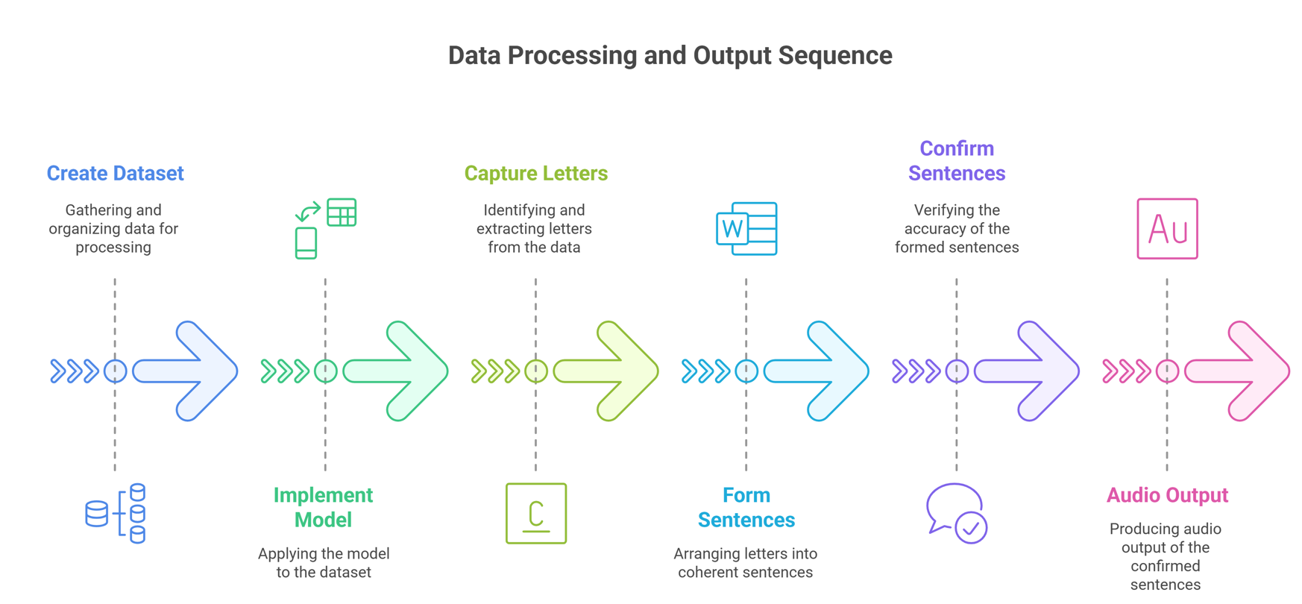
2.1 Work Flow
2. Methods and Work Flow

Slide 5
2.2 DATASET CREATION
import cv2
import mediapipe as mp
import pandas as pd
mp_hands = mp.solutions.hands
hands = mp_hands.Hands()
video = cv2.VideoCapture(0)
data = []
label = ‘LETTER WE NEED TO TRAIN'
Importing the needed modules
Load Mediapipe's hand-tracking module.
Initialize the hand detection model.
Access the webcam to capture live video frames.

Slide 6
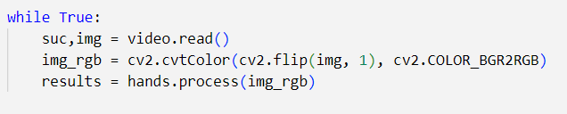
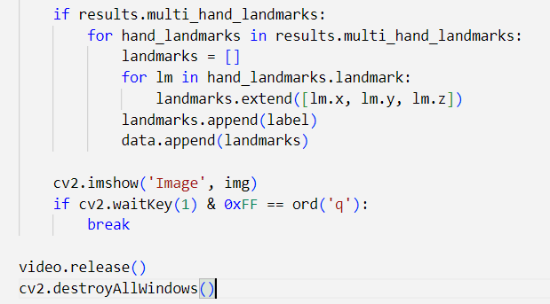
Reads a frame from the webcam, flips it (for mirror view), and sends it to MediaPipe for hand detection
Detects hands in real-time from webcam.
Extracts 3D landmark coordinates. Labels them.
Saves each sample to a list for model training.

Slide 7
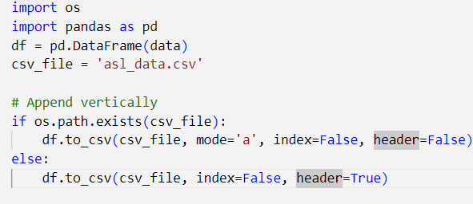
Asl_data.csv file is appended with data which was extracted before vertically

Slide 8
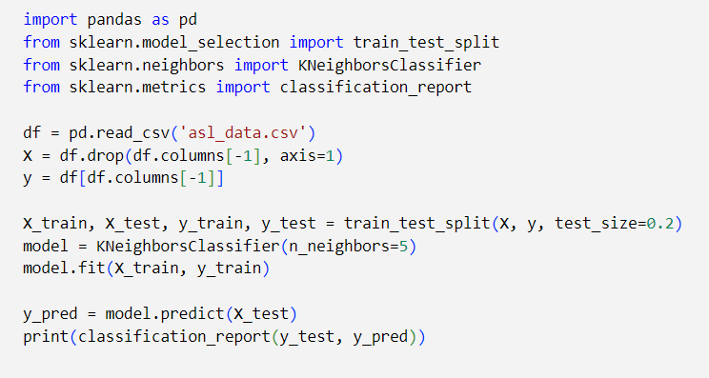
3.MODEL CREATION

Slide 9
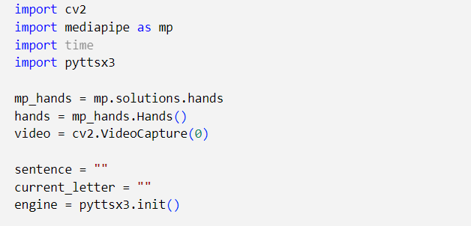
4.CAPTURING PHASE

Slide 10
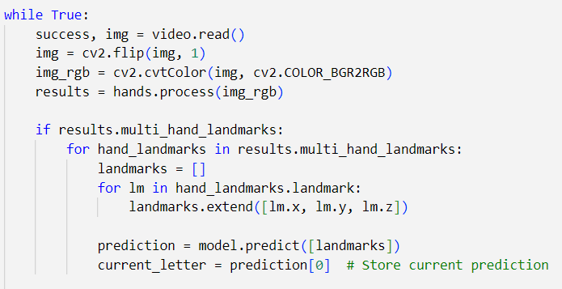
Reads webcam frames.
Detects hands using Mediapipe.
Extracts hand landmark coordinates. landmarks looks like:[x1, y1, z1, x2, y2, z2, ..., x21, y21, z21] → total of 63 values (21x3=63)
Feeds them into a trained model.
Predicts and stores the ASL letter being shown.

Slide 11
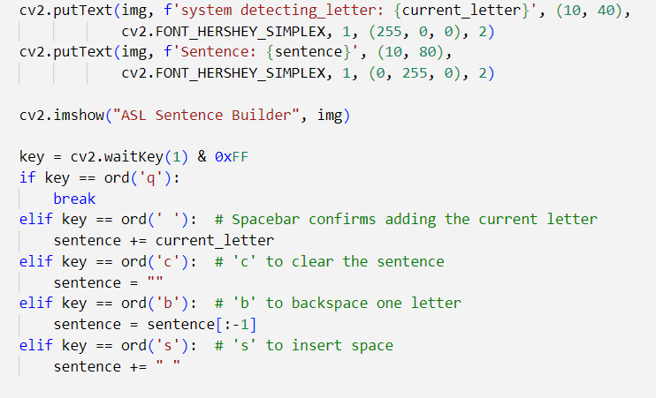

Slide 12
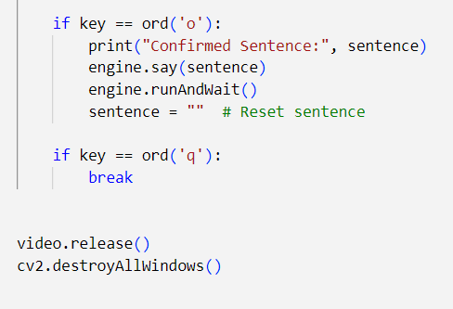

Slide 13
5.APPLICATIONS
Communication between differently abled people
ASL Learning and practice tool
Human computer interaction

Slide 14
6.RESULTS AS IMPLEMENTATION IN VS CODE
Developed an ASL (American Sign Language) recognition system using MediaPipe and OpenCV to detect and classify hand gestures in real-time with 3D hand landmarks.
Designed and implemented a custom dataset pipeline, capturing and labeling hand gesture data to train a machine learning model for accurate letter prediction.
Integrated gesture-based sentence formation with audio output using Python, enabling real-time communication aid for differently abled individuals.

Slide 16
Thank you

